Slide 1
Ecommerce Product Categorization
Mamun Rashid

Slide 2
Problem Statement:
In the rapidly evolving world of eCommerce, accurate product categorization is crucial for ensuring seamless customer experiences, reducing search friction, and increasing product discoverability. However, the sheer volume of diverse products poses a significant challenge. Current classification systems struggle to handle ambiguities, unconventional naming conventions, and multi-language data. This hackathon aims to address these challenges by inviting participants to create innovative solutions that enhance product categorization efficiency, accuracy, and scalability.
Develop a text classification model that categorizes products with maximum accuracy based on description of the product.

Slide 3
Problem Solving Approach
1. Explore and analyze the dataset to understand key features, detect missing data, and identify ambiguities.
2. Preprocess the dataset for consistency, noise reduction, and missing value handling.
3. Perform descriptive analysis to identify data patterns, category distributions, and inconsistencies, especially for text data.
4. Visualize data insights using word cloud and other text viz techniques.
5. Convert text descriptions into numerical features using techniques such as TF-IDF, word embeddings, or custom methods.
6. Design and develop machine learning models using text data for accurate product categorization.
7. Consider classification, clustering, or hybrid models based on problem requirements.
8. Compare the various model to get best performance.

Slide 4
Key Insights
The online platform’s highest selling brands are TheLostPuppy followed by Wallmantra.
The online platform’s moderate sales in category such as Theskinmantra, AdroitZ, Elite Collection, Digilight, Simrit.
The online platform’s least selling brands are Antshrike, GAGA, Manirathnum, Miss Clyra.

Slide 5
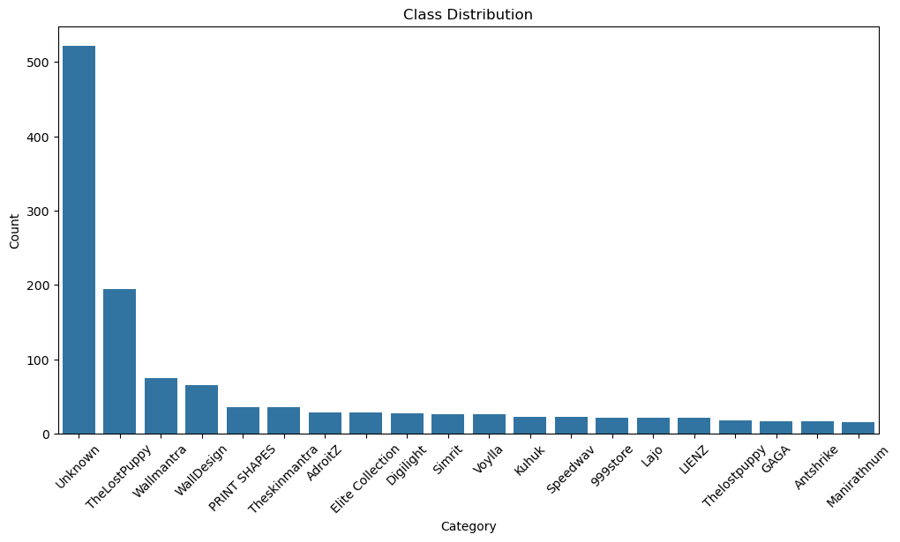

Slide 6
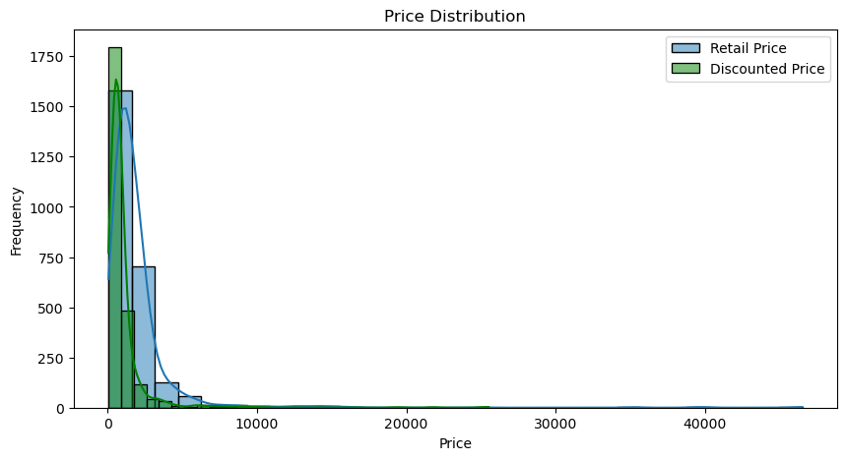

Slide 7
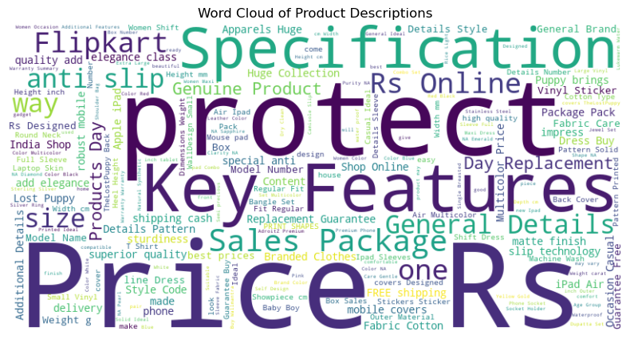

Slide 8
Data Preprocessing:
Steps taken:
Handled missing data.
Normalized text (e.g., removed punctuation, stopwords).
Transformed text using TF-IDF.
Before-and-after examples of text preprocessing.

Slide 9
Modeling:
Models tested (e.g., Logistic Regression, Random Forest, SVM).
Features used: TF-IDF representation of descriptions.
Highlight that multiple models were compared to select the best one.

Slide 10
Evaluation Metrics:
Define key metrics: accuracy, precision, recall, F1 score.
Highlight the model with the best performance.
A comparison table of metrics for all models.
Bar chart showing model performance.

Slide 11
Final Model:
Describe the selected model (e.g., Random Forest).
Key reasons for selection:
High F1 score.
Robust performance on the test set.
Confusion matrix of the final model.

Slide 12
Business Impact:
Time saved by automating categorization.
Improved accuracy compared to manual efforts.
Scalability of the solution.
Include potential financial or operational benefits.

Slide 13
Conclusion:
Summarize findings:
Data insights.
Model performance.
Business benefits.
Next steps for implementation or further research.
Use icons or bullet points for clarity.

